Slide 1
DOGE and Graduate Support Meeting
September 17, 2019
Graduate Enrollment
Recruitment Events
Recruitment Programs

Slide 2
Graduate Enrollment
4,498 down 5.8% from 4,774
in 2018-19

Slide 3
Graduate Majors (20+ students) that Grew
Analytical Chemistry ● Applied Linguistics and Technology ● Business Administration ● Chemistry ● Crop Production and Physiology ● Ecology and Evolutionary Biology ● Information Systems ● Kinesiology ● Mechanical Engineering ● Microbiology ● Organic Chemistry ● Physics ● Psychology ● Seed Technology and Business ● Toxicology

Slide 4
Underrepresented Graduate Students
384 total
(8.5%)
52
Two or more
177
Hispanic
140
African American / Black
9
Native American
6
Hawaiian

Slide 5
Underrepresented Graduate Students
384 total
(8.5%)
117
off-campus courses only
28
on- and off-campus courses
239
on-campus courses only
5.9% of on-campus students
3 majors account for 27%
39 majors have majority students only
Notes:
Three majors: Education, Mathematics, Psychology
With two more majors (HD FS, ME)…30%

Slide 6
2019 – 20 Recruitment Events
Heartland McNair Conference, Kansas City MO
Spelman College, Atlanta GA
Within Iowa – Central College (Pella) and Loras College (Dubuque)
Pennsylvania State University Behrend, Erie PA; Cleveland State University
University of Illinois Chicago Graduate Fair (Chicago schools)
Northern California Forum for Diversity – Sonoma State University
University of Houston-Downtown (STEM Academy), Houston TX
Western and Central Illinois – Bradley, Milliken, Knox, Monmouth, Augustana
University of North Texas McNair Conference, Denton TX
Southern California Forum for Diversity – UCLA

Slide 7
2019 – 20 Recruitment Events
Undergraduates at Iowa State University
Tuesday October 22, 5 p.m.
Wednesday October 23, 5 p.m.
Thursday October 24, noon

Slide 8
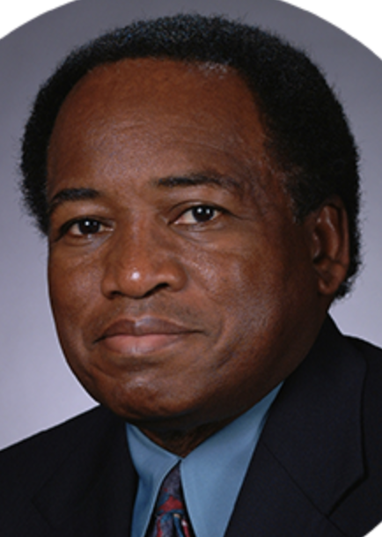
2019 - 20 Recruitment Programs (tentative)
George A. Jackson Student Fellowship and Faculty Award
Ph.D. & Ed.D.
$30,000 for five years
Funding split to be determined
Workshop expected
Funds for professional development
Replaces AGEP and GWC programs
open to all doctoral majors

Slide 9
2019 - 20 Recruitment Programs (tentative)
Tuition Award for Diversity
Master’s students appointed ½ time
Up to 2 years
Covers tuition student would pay
open to all master’s majors

Slide 10
2019 - 20 Recruitment Programs (tentative)
Ronald E. McNair Scholarship
Master’s, Ph.D., Ed.D. students
$6,000 (master’s) or $9,000 (doctorate)
Half in first year
Half when POSC fully approved
$60 application fee waived for all McNair Scholars
open to all majors

Slide 11
2019 - 20 Recruitment Programs (tentative)
Graduate Dean Scholar Program
Master’s, Ph.D., Ed.D. students
$30,000 / $33,000 / $36,000 / $39,000
One to five years
Graduate College (2/3), academic college (1/3)
POSC required by end of year 1 (master’s) or 2 (doctoral)
Graduate College Scholar Program suspended
open to majors that grew

Slide 12
2019 - 20 Recruitment Programs (tentative)
Cyclone Collaborative Scholarship Program
$5,000 to master’s students (once)
$10,000 to doctoral students (once)
Half paid by Graduate College, half by academic college
Assistantship appointment is optional
majors selected by academic colleges

Slide 13
2019 - 20 Recruitment Programs (tentative)
Graduate College 1913 Relocation Scholarship
Graduate College 1913 On-line Scholarship
Master’s, Ph.D., Ed.D.
$1,913 upon matriculation
combinable
open to all majors

Slide 14
Graduate College-based Application Option
Free and user-friendly preliminary application
Rapid preliminary assessment of admissibility
Remaining questions:
Who completes Admissions application?
Who pays application fee

Slide 15
Three Minute Thesis (3MT)
Judy Strand, Denise Vrchota, Misty Treanor, Sarah Huffman
Academic College | 2019 | 2018
Agricultural and Life Sciences | 10 | 17
Business | 1 | 1
Design | 2 | 2
Engineering | 19 | 31
Human Sciences | 1 | 6
Liberal Arts and Sciences | 12 | 22
Veterinary Medicine | 4 | 4
Grand Total | 49 | 83
Deadline: 9/22
Incentives
Judges

Slide 16
Is there a need for supplemental funding for Fulbright Scholars and students supported by their home country?
Stipends often lower than Grad College minimum.
Review schedule for interdepartmental graduate programs: 2020/21 external review visits:
Biological sciences: Microbiology, Plant Biology, Seed Technology and Business, Immunobiology, Toxicology, Sustainable Agriculture
Engineering: Cyber Security, Wind Energy Science, Engineering, and Policy, Human-Computer Interaction
Graduate program learning outcomes
Mandated by Higher Learning Commission, our accreditation body
Must be articulated, measured, and used to improve instructional programs; Proposal under consideration by Graduate Council
Disability Accommodations for assistantship success
Contact Associate Dean Carolyn Cutrona: ccutrona@iastate.edu

