Slide 1
Graduate council meeting
January 22, 2020

Slide 2
Call to order
Seating of substitute council members
Consent Agenda
  Dual-list: HIST 498/598
  Dual-list: IE 437/537
  Dual-list: MAT E 475/575
  Dual-list: Math 422/522
  Dual-list: BBMB 445/545
  Elimination of Technology and Innovation Management Specialization
  Concurrent BS in Cyber Security and MBA

Slide 3
Announcements and Remarks
Bethany Gray, Chair
Bill Graves, Dean of the Graduate College
Carolyn Cutrona, Associate Dean of the Graduate College
Judy Strand, Graduate College Office

Slide 4
Old business
Exceptions to full graduate faculty status
POSC deadline and timeframe before preliminary exam
Dismissal of postdocs for loss of funding
Change to credit take as undergraduate policy
Bridge Funding for arrival of new child
Notes:
Matthew Ellinwood

Slide 5
Old business
Exceptions to full graduate faculty status
POSC deadline and timeframe before preliminary exam
Dismissal of postdocs for loss of funding
Change to credit take as undergraduate policy
Bridge Funding for arrival of new child
Notes:
Matthew Ellinwood

Slide 6
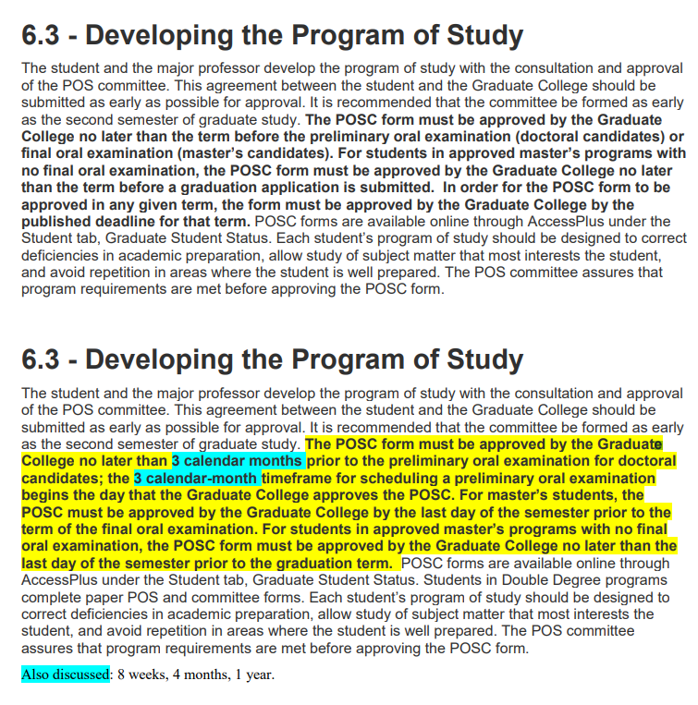
POSC deadline and timeframe before preliminary exam

Slide 7
Old business
Exceptions to full graduate faculty status
POSC deadline and timeframe before preliminary exam
Dismissal of postdocs for loss of funding
Change to credit take as undergraduate policy
Bridge Funding for arrival of new child
Notes:
Matthew Ellinwood

Slide 8
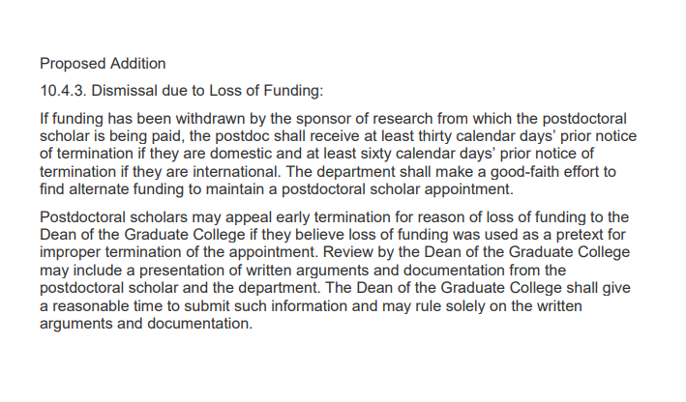
Dismissal of postdocs for loss of funding

Slide 9
Old business
Exceptions to full graduate faculty status
POSC deadline and timeframe before preliminary exam
Dismissal of postdocs for loss of funding
Change to credit take as undergraduate policy
Bridge Funding for arrival of new child
Notes:
Matthew Ellinwood

Slide 10
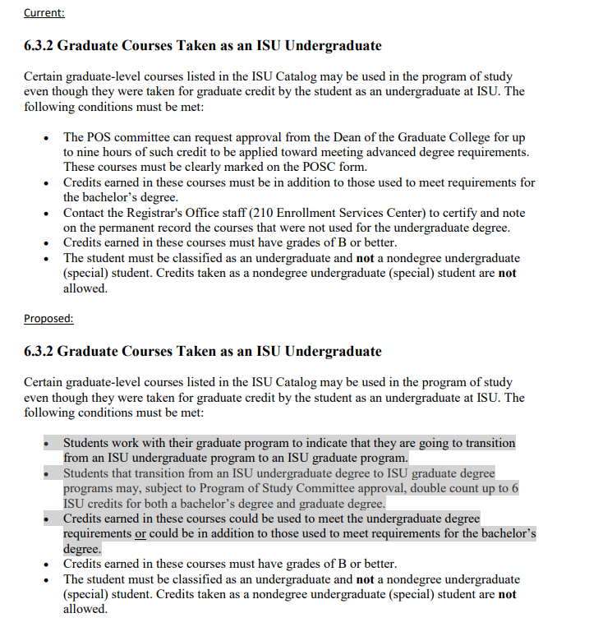
Change to credit take as undergraduate policy

Slide 11
Old business
Exceptions to full graduate faculty status
POSC deadline and timeframe before preliminary exam
Dismissal of postdocs for loss of funding
Change to credit take as undergraduate policy
Bridge Funding for arrival of new child
Notes:
Matthew Ellinwood

Slide 12
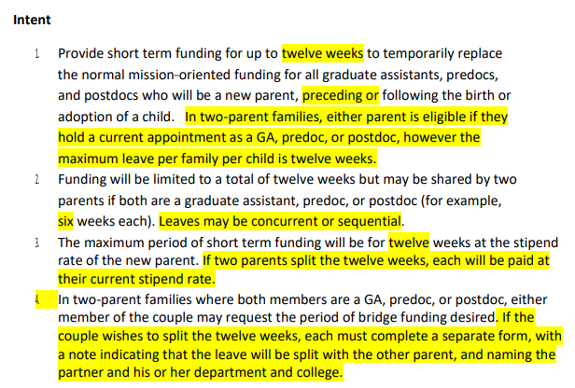
Bridge Funding for arrival of new child

Slide 13
New Business
Expired Courses for MFA degrees

Slide 14
Expired course policy
https://www.grad-college.iastate.edu/handbook/chapter.php?id=6&search=expired%20course&section=6.3#search
Issues that have been raised:
  Expired course policies negatively impact students who pursue non-academic career paths in between a master’s and doctoral program
  May be a deterrent for students entering doctoral programs from industry
  MFA students are currently considered Masters students, despite the fact that it is a terminal degree program, typically require more credits, and attract students with earned graduate degrees
Notes:
Revisit expired courses policy. The proposal relayed to me is to not have an expired course policy for any course that was part of a completed degree. One rationale here was that the current expired courses requirement has a particularly negative impact on students who pursue non-academic careers between a master’s and doctoral degree. (and, given the AAU initiative, and the university’s interest in supporting career paths ‘beyond academic’, it seems like this could be a compelling argument and evidence that ISU supports such industry career paths for master’s students.
SOME POLICIES ARE BY TERMINAL VS. NON-TERMINAL DEGREE, WHILE OTHERS ARE BY MASTERS VS PHD LEVEL

Slide 15
Expired Course Policy
https://www.grad-college.iastate.edu/handbook/chapter.php?id=6&search=expired%20course&section=6.3#search
 | ≥ 7 years | 8-10 years | 11+ years
Masters | unlimited | 6 credits | 0 credits
PhD | unlimited | unlimited | 36 credits (no more than 12 > 16 yrs)

Slide 16
Other Items
Any other items from the graduate council members
  External POS members (and COI issues)
  Tuition scholarships for master’s students

Slide 17
POS Membership issues
Purpose and definition of the external POS committee member
  Current handbook language: Member(s) from Outside the Student’s Field of Emphasis. The outside graduate faculty member(s) of the POS committee provide relevant specialized knowledge or a different perspective helpful to the planning, execution, and reporting of research, or some aspect of intellectual diversity deemed important by the committee and/or major.
Dealing with conflicts of interest within the POS committee
  Examples: POS member(s) as PI on grant as basis of thesis/dissertation; close relationships between POS members

Slide 18
Master’s graduate assistant tuition scholarship rate
3.3.1 Graduate Assistantship Tuition Scholarships
Graduate students appointed to a graduate assistantship appointment of 1/4-time or more for at least 3 months in fall and spring terms and for 4 weeks in summer term, are assessed tuition at the full-time resident (in-state) rate for the fall and spring term. Summer term tuition is assessed at resident (in-state) rate for the number of credits registered for. The graduate assistantship tuition scholarships are not paid directly to the student, but are applied to the student’s tuition bill. The scholarship awards are equal to:
For a master’s student:
  50% of full-time tuition per semester for each student on an assistantship appointment of 1/2-time or more or
  25% of full-time tuition per semester for each student on an assistantship appointment of 1/4-time or more, but less than 1/2-time.
For a Ph.D. (and terminal master’s program) student:
  100% of full-time tuition per semester for each student on an assistantship appointment of 1/2-time or more or
  50% of full-time tuition per semester for each student on an assistantship appointment of 1/4-time or more, but less than 1/2-time.
  https://www.grad-college.iastate.edu/handbook/chapter.php?id=3#3.2
Notes:
An issue that has been raised in multiple venues is the issue of tuition scholarships at the master’s level. I’ve now heard from multiple departments across at least 2 colleges that only having 50% tuition scholarships for master’s students on a ½ assistantship is directly impacting their recruitment efforts because peer institutions offer full tuition scholarships for those students. It may be that this discussion has been had in the past, so I thought I’d mention it here before adding it to the agenda.

