Slide 1
Graduate council meeting
November 20, 2019

Slide 2
Call to order
Seating of substitute council members
Consent Agenda
  BA/MA in English/Linguistics
  Dual-list of Math 423/523; Math 469/569

Slide 3
Announcements and Remarks
Bethany Gray, Chair
Bill Graves, Dean of the Graduate College
Carolyn Cutrona, Associate Dean of the Graduate College
Judy Strand, Graduate College Office

Slide 4
Old business
Exceptions to full graduate faculty status
POSC Deadline and timeframe before preliminary exam
Notes:
Matthew Ellinwood

Slide 5
Old business
Exceptions to full graduate faculty status
POSC Deadline and timeframe before preliminary exam
Notes:
Carolyn Cutrona

Slide 6
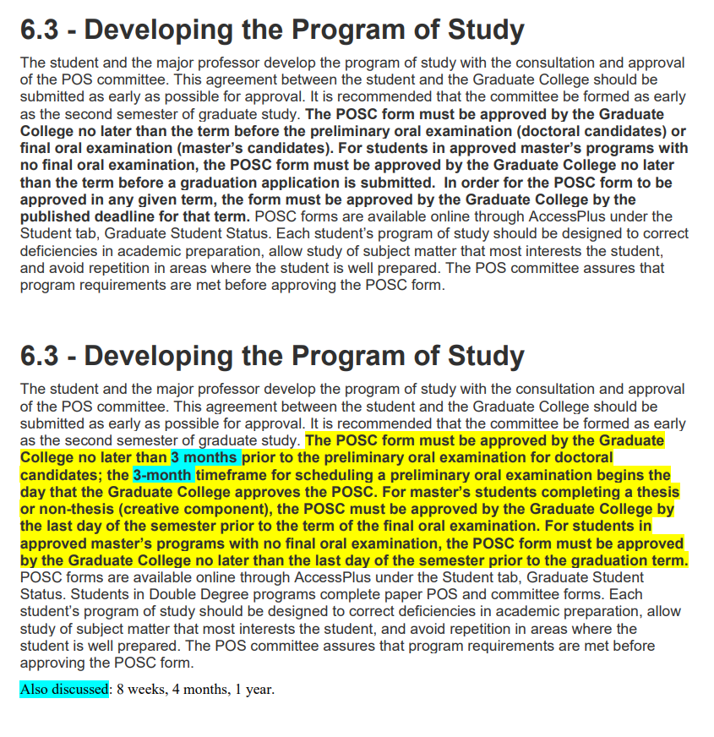

Slide 7
New business
Dismissal of Postdocs due to loss of funding
Change in credit taken as undergraduate counting toward graduate degree
Bridge funding for arrival of new child
Grading options for 699 credits

Slide 8
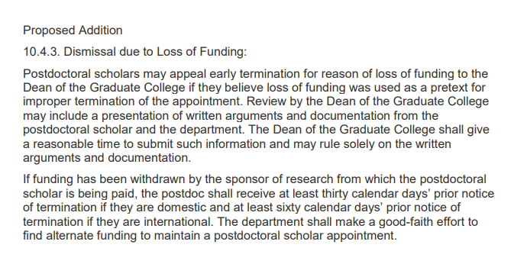

Slide 9
New business
Dismissal of Postdoc due to lack of funding
Change to credit taken as undergraduate counting toward graduate degree
Bridge funding for arrival of new child
Grading options for 699 credits

Slide 10
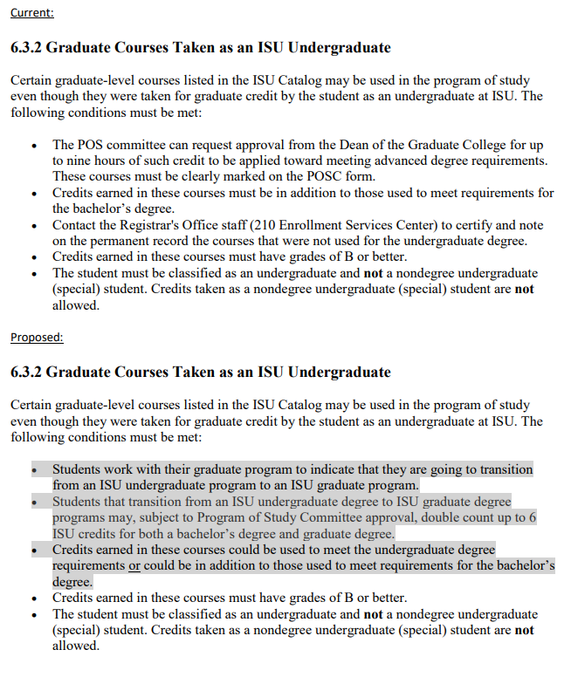

Slide 11
New business
Dismissal of Postdoc due to lack of funding
Change to credit taken as undergraduate counting toward graduate degree
Bridge funding for arrival of new child
Grading options for 699 credits

Slide 12
New business
Dismissal of Postdoc due to lack of funding
Change to credit taken as undergraduate counting toward graduate degree
Bridge funding for arrival of new child
Grading options for 699 credits

Slide 13
Other Items
Any other items from the graduate council members
  POSC membership issues and conflicts of interest
  Expired course policies
  Tuition scholarships for master’s students
  Final oral exams (public vs. private)

Slide 14
POS Membership issues
Purpose and definition of the external POS committee member
  Current handbook language: Member(s) from Outside the Student’s Field of Emphasis. The outside graduate faculty member(s) of the POS committee provide relevant specialized knowledge or a different perspective helpful to the planning, execution, and reporting of research, or some aspect of intellectual diversity deemed important by the committee and/or major.
Dealing with conflicts of interest within the POS committee
  Examples: POS member(s) as PI on grant as basis of thesis/dissertation; close relationships between POS members

Slide 15
Expired course policy
https://www.grad-college.iastate.edu/handbook/chapter.php?id=6&search=expired%20course&section=6.3#search
Issue that has been raised:
  Expired course policies negatively impact students who pursue non-academic career paths in between a master’s and doctoral program
  May be a deterrent for students entering doctoral programs from industry
Notes:
Revisit expired courses policy. The proposal relayed to me is to not have an expired course policy for any course that was part of a completed degree. One rationale here was that the current expired courses requirement has a particularly negative impact on students who pursue non-academic careers between a master’s and doctoral degree. (and, given the AAU initiative, and the university’s interest in supporting career paths ‘beyond academic’, it seems like this could be a compelling argument and evidence that ISU supports such industry career paths for master’s students.

Slide 16
Master’s graduate assistant tuition scholarship rate
3.3.1 Graduate Assistantship Tuition Scholarships
Graduate students appointed to a graduate assistantship appointment of 1/4-time or more for at least 3 months in fall and spring terms and for 4 weeks in summer term, are assessed tuition at the full-time resident (in-state) rate for the fall and spring term. Summer term tuition is assessed at resident (in-state) rate for the number of credits registered for. The graduate assistantship tuition scholarships are not paid directly to the student, but are applied to the student’s tuition bill. The scholarship awards are equal to:
For a master’s student:
  50% of full-time tuition per semester for each student on an assistantship appointment of 1/2-time or more or
  25% of full-time tuition per semester for each student on an assistantship appointment of 1/4-time or more, but less than 1/2-time.
For a Ph.D. (and terminal master’s program) student:
  100% of full-time tuition per semester for each student on an assistantship appointment of 1/2-time or more or
  50% of full-time tuition per semester for each student on an assistantship appointment of 1/4-time or more, but less than 1/2-time.
  https://www.grad-college.iastate.edu/handbook/chapter.php?id=3#3.2
Notes:
An issue that has been raised in multiple venues is the issue of tuition scholarships at the master’s level. I’ve now heard from multiple departments across at least 2 colleges that only having 50% tuition scholarships for master’s students on a ½ assistantship is directly impacting their recruitment efforts because peer institutions offer full tuition scholarships for those students. It may be that this discussion has been had in the past, so I thought I’d mention it here before adding it to the agenda.

Slide 17
Final exams open or closed to public
https://www.grad-college.iastate.edu/handbook/chapter.php?id=7#7.1
Notes:
We received an issue from a graduate student about final oral exams not being public or announced in departments. I believe that current policy is that whether a defense is open to the public or not is up to departments to decide (but the schedule is available via the Grad College website). This inquiry wanted us to revisit whether the Grad College or departments should make the decision on whether final oral defenses should be public or not.

