Slide 1
Modernizing the Student Information System (SIS) and Receivables
Graduate Council
March 24, 2021
Notes:
Laura

Slide 2
Agenda
Current SIS
Workday Student Evaluation Process
Timeline
Plan and Communicate
Governance
Next steps
Notes:
Laura

Slide 3
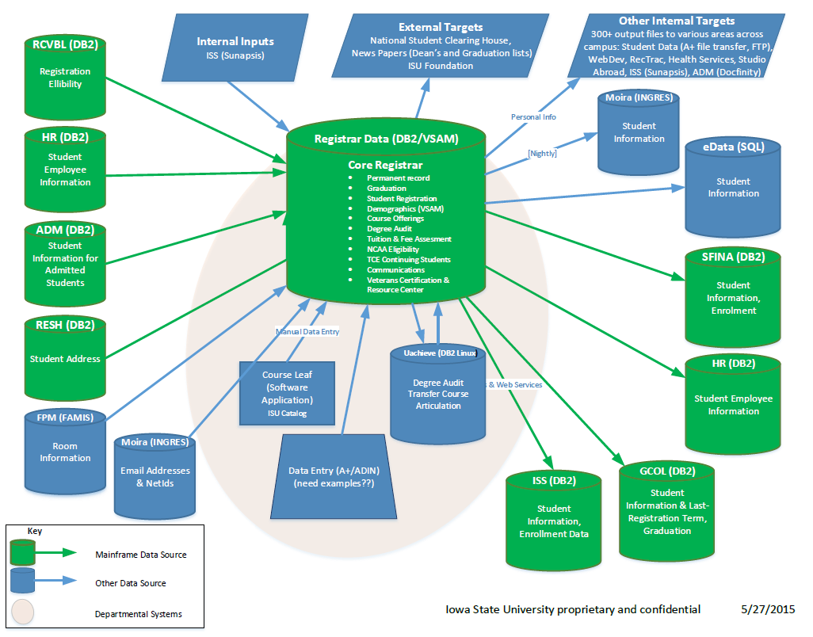

Current SIS
ADIN and
Used by students, faculty, advisers, and staff
Aging technology
Multiple/disparate systems
Complex data management model that is supplemented with Excel & Access
Notes:
Laura
KPC: (just comment). The three key points are the complexity, and the departmental systems – most of which we have incomplete knowledge or control off. The other point is that data is often transferred in 'batches' at a particular time, meaning that it is not 'real time' - which can be a problem depending upon how quickly it changes and how it is used.

Slide 4
Due Diligence
Benefits of Workday
Cloud based, powerful, robust, and adaptable
Risks (of maintain current state)
On site, outdated, restrictive and fragile
Readiness Assessment Complete
Step 1: Fit-Gap Evaluation
Step 2: Demonstrations by WD
Step 3: Virtual Site Visits
Step 4: Develop a Business Case
Notes:
Jee

Slide 5
Timeline
Phased Implementation for Business Function Go-Lives
June 2023:
Recruiting & Admissions
Application Fees & Tuition Deposits
Academic Calendar
Academic Units
Programs of Study
Student Core
March 2024:
Registration & Advising
Tuition & Fee Assessment
Continuing Student Financial Aid
Student Record Conversion
April 2021- January 2022
• Plan and Discovery
December 2024:
Grading
Graduation
Transcripts
End-of-Term Processing
September 2021–May 2023:
Design, Configure, and Prototype
2021
2022
2023
2024
2025
October 2021–December 2024:
Test
September 2023:
New Student Financial Aid
Course Catalog
Class Schedule
September 2024:
Financial Aid Distribution
Billing
Payment Processing
January 2025:
Full Production
January 2025-February 2026
Postproduction Support
Notes:
Jennifer or Diane

Slide 6

Plan and Communicate - Ongoing
Plan
Communicate
Campus announcements
Begin Workday Student training
Develop the change management and communications plan
Formalize the governance structure and teams
Confirm the budget management process
Project kick-off
Road shows
Regularly attend meetings and provide project updates
Written communications
Website
Engage existing groups
Notes:
Jennifer or Diane

Slide 7
Project Governance Approach
ISU employee
Huron consultant
Co-Leads – K. Constant and S. Mickelson
Consultant
Team
ISU
Team
Program Sponsors
Steering
Committee
Quality
Assurance Team
Example of a
2-In-The-Box
Approach
Project Leadership Team
PROJECT LEADERSHIP TEAM
PROJECT ADVISORY
Program
Director
Student
Functional Team
Change
Mgmt Team
Receivables
Teams
Technical
Team
Engagement
Manager
Recruiting and Admissions
Academic Foundation
Student Records
Acad. Advising & Curriculum
Student Financials
Financial Aid
Communication
Training Development and Delivery
Change Liaisons
Tuition/Fees Assessment
Student Billing
Non-student receivables
Integrations
Data Conversion
Security
Reporting
Student
Experience Team
Testing and Subject Matter Experts Across All Teams
Notes:
Carol

Slide 8
Advisory Groups
The steering committee makes decisions
Advisory groups provide input
Possible/Planned advisory groups (member sits on steering committee?)
  Faculty
  Students
  Graduate College and Research
  Receivables
  Advising
  Student Support (ISSO, SA, ASC, Res. Multicultural … etc)

Slide 9
Next Steps
Workday Student project status updates for campus groups
  Develop and implement robust communications plan
Statement of Work
  Professional Services contracts with Huron and Workday
  Development of Timeline/Deliverables
Enrollment, Receivables, and IT Services Leaders
  Evaluate leadership and team assignments
  Identify backfill needs
Notes:
Kristen

Slide 10
Plan and Discovery Phase
April 2021-January 2022
  10 months
  7 Workstreams
28 Deliverables including:
  Reporting & Integration inventories
  Change Management strategy and plan
  Policy and Process inventories
Adjust forward
Notes:
Kristen

Slide 11
Plan and Discovery Workstreams – page 1
Governance and Project Management:
Activities and frameworks that provide structure and procedures to enable the delivery of the Plan and Discovery phase.
Strategy and Approach:
A series of activities and deliverables to inform how various functional, technical, and change aspects of the project will be defined. Guardrails will be established, approach will be defined, and scope will be confirmed. These deliverables will be referenced throughout project.
Student, Faculty, and Staff Experience:
A series of interviews and assessments through the lens of students, faculty and staff. The voice of these stakeholders will underpin the ongoing engagement as guiding principles and influence the decisions that will impact the design and subsequent implementation of Workday Student and Receivables .
Change Management:
A series of activities and deliverables to develop a foundation during the project for communications and the change journey for the modernization of ISU’s systems and processes. The activities in this workstream will ultimately prepare students, faculty and staff for the use of Workday Student and Receivables.
Notes:
Kristen

Slide 12
Plan and Discovery Workstreams – page 2
Process Transformation and Improvement:
A series of activities to review current processes, identify and prioritize the areas which offer the most opportunity to streamline, simplify and in some cases transform the way work is done. Efforts in this workstream result in the future state design of high priority processes. The designs will inform the configuration activities to follow in the Architect, Configuration and Prototype phases.
Data Conversion and Transformation:
The technical and functional teams will analyze current and future state data requirements and document in the Data Dictionary how data will be translated, transformed, and converted into Workday.
Foundation Tenant Build:
Using the accumulation of information collected across each workstream, the Foundation Tenant will be created with ISU’s preliminary configurations and a subset of the university’s data.
Notes:
Kristen

Slide 13
Thank you!
Discussion and Questions
Notes:
Laura

